Slide 1
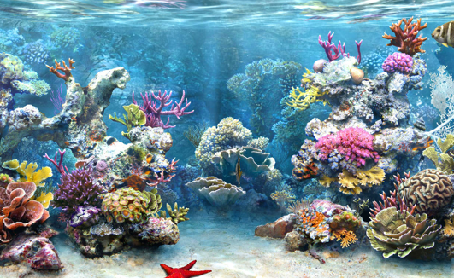
Coral reef
By quentin

Slide 2
There are 3 kind of coral reef.
Barrier reef grow on shoreline.
Frining reefs-are permanent with the landmass.
Atolls – island made of coral.

Slide 3
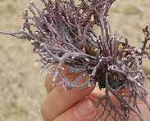
Plant
Coralline algae- They are spread out on the ocean bed. Corallines algae are made of very find thread-like filaments.

Slide 4
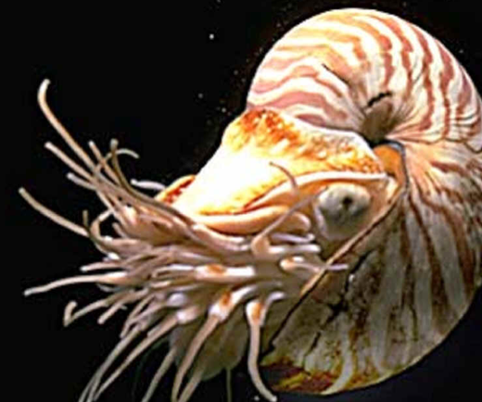
Animals
It has mollusks, crustacean.

Slide 5
locations
On the ocean suface.

